Slide 1

Digital Delay Lines
Used as the basis for many audio effects:
  Slapback Echoes and Multi-Tap Delays
  Doubling and Haas Effects
  Comb Filters and Resonators
  Chorus, Flanging, and Phase Shifting
  Pitch Shifting and Harmonization
  Reverbs and Room Simulations

Slide 2
Basic Csound Delay Units
Simple, Self-Contained Delay Units:
ar delay asig, idlt[, iskip]
…simple delay of idlt seconds
ar delay1 asig[, iskip]
…single sample delay (useful in FIR filters)
ar vdelay asig, adel, imaxdel[, iskip]
…variable delay of adel seconds, which must be positive
and <= imaxdel

Slide 3
Simple Slapback Delay Example
instr 1 ;pluck with echoes
kgate linseg p4,.1,0,1,0 ;.1 second ramp
icps = cpspch(p5) ;p5 in pch
asig pluck kgate,icps,icps,0,1,0,0 ;simple pluck
;Make two slapback echoes, each one softer than the input:
atap1 delay asig*.7,p6 ;p6 second delay
atap2 delay asig*.5,p7 ;p7 second delay
outs asig+atap1,asig+atap2 ;add stereo echoes
endin

Slide 4

Score for Instrument 1
;Sample Score for Pinkston Delay Chapter Instrument 1
;Note that p3 must be long enough to include both echoes
; st dur amp pch echo1 echo2
i1 0 .5 20000 7.00 .15 .4
i1 1 . . 7.07
i1 1.5 . . 8.04
i1 2 . . 8.10
e

Slide 5
Version with Global Variables
instr 2 ;dry pluck
gasend init 0 ;init global "send"
kgate linseg p4,.1,0,1,0 ;.1 second ramp
icps = cpspch(p5) ;p5 in pch
asig pluck kgate,icps,icps,0,1,0,0 ;simple pluck
outs asig,asig ;straight out
gasend = gasend+asig ;add to global var
endin
;------------- A global effect instrument -----------------;
instr 3 ;stereo echoes
atap1 delay gasend*p4,p6 ;use global var
atap2 delay gasend*p5,p7 ;for inputs
outs atap1,atap2 ;stereo echoes
gasend = 0 ;clear global var
endin

Slide 6
Score for Instruments 2 & 3
;Play a short 2-part harmony; note durs = pluck durs
; st dur amp pch
i2 0 .1 15000 7.00
i2 0 . . 7.04
i2 1 . . 7.07
i2 1 . . 8.05
i2 1.5 . . 8.04
i2 1.5 . . 8.00
i2 2 . . 8.10
i2 2 . . 9.02
;Global delay instr is on for entire passage + longest echo
; st dur fac1 fac2 echo1 echo2
i3 0 2.5 .7 .5 .15 .4
e

Slide 7
Simple Vibrato with vdelay
instr 4 ;vdelay vibrato
icps = cpspch(p5) ;basic pitch
ilfohz = p6 ;LFO rate in cps
idelfac = p7 ;between 0 & .999
imaxdel = p8 ;max delay in secs
ilfoamp = idelfac*imaxdel/2 ;lfo fn is +/- 1
kgate linen p4,.1,p3,.2 ;basic note envlp
avardel oscili ilfoamp,ilfohz,1 ;fn1 is LFO wave
asig oscili kgate,icps,2 ;fn2 is Osc wave
adelay = imaxdel/2+avardel ;offset to .5 max
aout vdelay asig,adelay,imaxdel ;varying delay
outs aout,aout
endin

Slide 8
Score for Instrument 4
;Sample Score for Pinkston Delay Chapter Instrument 4
;LFO wave is a sine
f01 0 512 10 1
;Oscil wave
f02 0 512 10 1 .5 .3 .2 .1
;LFO depth factor is .9, gradually increase max delay time
; st dur amp pch lfohz depth maxdlt
i4 0 3 10000 8.00 5 .9 1
i4 + . . . . . 2
i4 + . . . . . 3
i4 + . . . . . 4
e

Slide 9
Other Csound Delay Units
Opcodes Used In Constructing Delay Networks:
ar delayr idlt[, iskip]
…begins a delay network of idlt seconds
delayw asig
…ends a delay network and inputs audio signal
ar deltap kdlt
ar deltapi xdlt
…output units, or taps, which must be placed between a delayr/delayw pair.

Slide 10
Simple Delay with delayr/w
instr 1 ;pluck with echoes
kgate linseg p4,.1,0,1,0 ;.1 second ramp
icps = cpspch(p5) ;p5 in pch
asig pluck kgate,icps,icps,0,1,0,0 ;simple pluck
;Make two slapback echoes, each one softer than the input:
amaxd delayr 3 ;max delay of 3 sec
atap1 deltapi p6 ;p6 second delay
atap2 deltapi p7 ;p7 second delay
delayw asig
outs asig+atap1*.7,asig+atap2*.5 ;add stereo echoes
endin

Slide 11
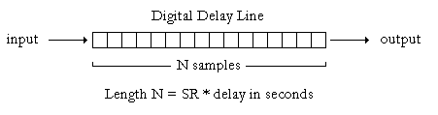
Understanding Delay Buffers
DDLs store audio in internal “buffers”
Size of buffer = SR * maximum delay in secs

Slide 12
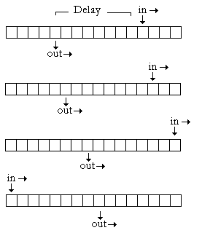
Input and Output Pointers
OutPtr = InPtr – N
N = SR * Delay Time
N <= Buffer Length
Output always taken before next input
Both Ptrs increment every sample
Ptrs “wrap” at end

Slide 13
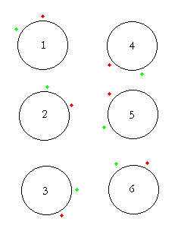
Circular Buffers
Delay buffers are sometimes called “circular” buffers, because the input and output pointers cycle through them repeatedly, wrapping around the buffer’s end point
The distance (# of samples) between the two pointers determines the delay time, which can never exceed the length of the buffer

Slide 14
General Notes
Multiple outputs (“taps”) are possible from a single delay buffer.
Taps can be independently scaled and panned. They can also be variable, which can produce pitch shifts.
Summing a complex audio signal delayed by a small amount (< 50ms) with the original results in cancellations and reinforcements of particular frequency components.

Slide 15
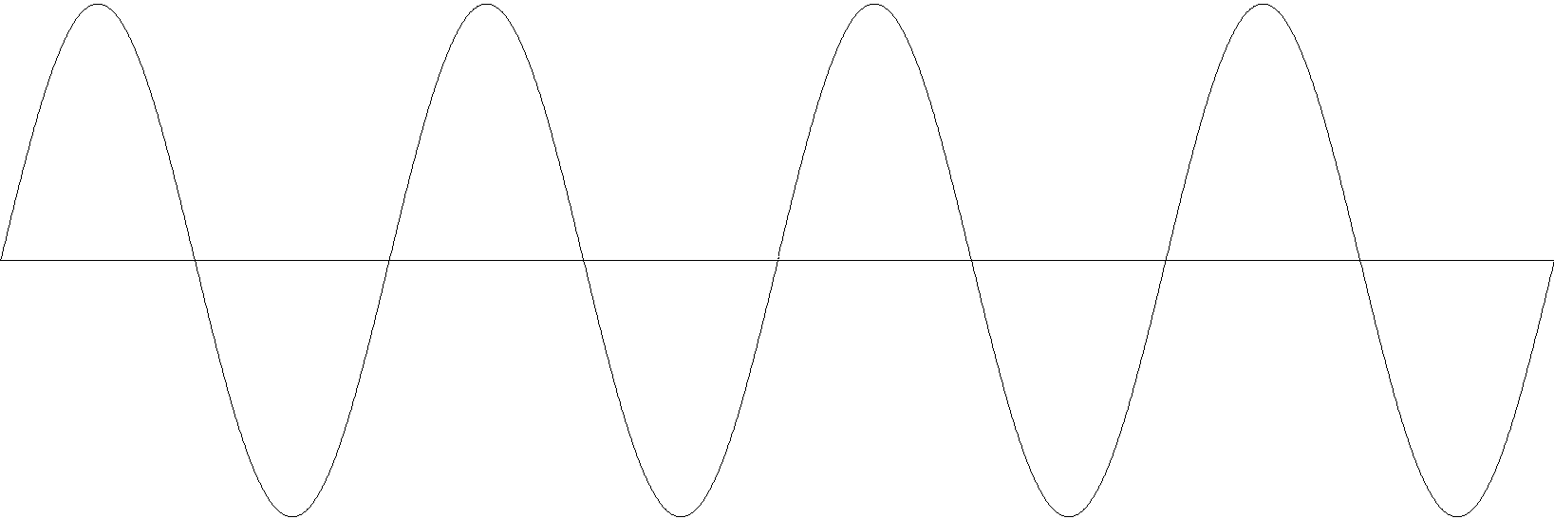
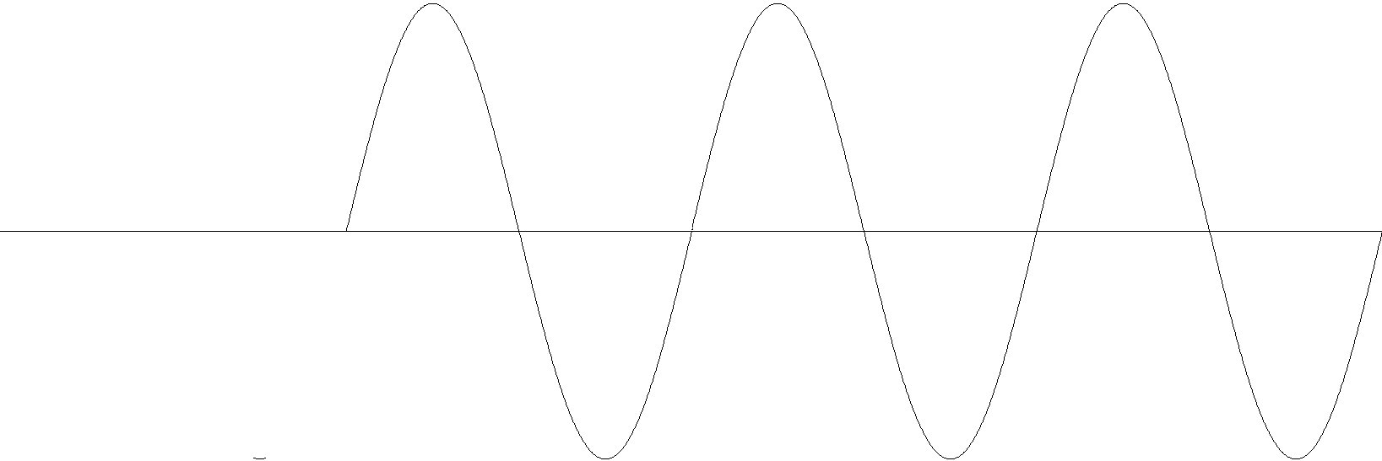
Cancellations and Reinforcements
A sine wave…
…will be cancelled out if added to itself delayed by ½ its fundamental period.
…will be reinforced if added to itself delayed by its fundamental period.

Slide 16
Flanging
A common effect that can be simulated by summing a signal with a delayed copy of itself and varying the delay time periodically.
Delay time typically very short (< 50 ms).
As the delay time increases from 0, progressively lower frequencies are cancelled or reinforced.
Varying the delay time periodically produces a “whooshing” effect caused by nulls and peaks sweeping up and down through the spectrum.

Slide 17
Delay With Feedback
Some or all of the output signal from a delay line can be fed back into the unit.
With short delays (< 50 ms), feedback will result in strong resonance: comb filtering
Comb filtering takes its name from the frequency response it produces, which resembles the teeth of a comb: sharp resonant peaks across the spectrum, at integer multiples of the fundamental frequency (1/Delay Time), forming a harmonic series.

Slide 18
Pitch Shifting
Pitch Shifting is achieved by moving an output pointer faster or slower than the input pointer.
This is equivalent to “resampling” – playing back at sound at a different speed than it was recorded.
Vibrato can be produced with a delay line by varying the delay time periodically with an LFO. The Csound vdelay unit is useful for this.

Slide 19
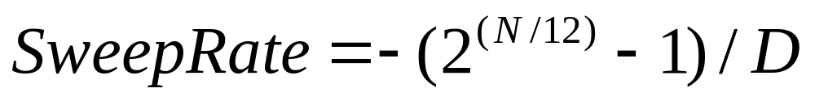
Shifting by Specific Intervals
To produce a continuous pitch shift at a fixed interval, the delay time must be varied linearly at a specific rate, proportional to the amount of shift.
To shift up, continually shorten the delay time. To shift down, continually lengthen the delay time.
Sweep the delay time linearly from 0 to the maximum delay (or vice versa). Use phasor.
Sweep Rate for producing N semitones of shift in a delay line D seconds long:

Slide 20
Continuous Pitch Shifting, Cont.
As the delay time of a particular tap sweeps past 0, the output pointer will cross the input pointer, which will cause a click.
Hence, continuous pitch shifting requires periodic gating between (at least) 2 taps, whose delay times are being varied at the same rate, but whose current positions are always separated by ½ the length of the delay line.
We never “listen” to a tap as it crosses 0.

Slide 21
Reading Assignment
Read Boulanger Chapter 22 – RP: Using Csound to Understand Delay Lines and Their Applications
Read Csound Manual about delay, vdelay, delay1, delayr, delayw, deltap, deltapi
Experiment!

